Slide 1



Linking Verbs
Differentiating between
Predicate Adjectives and Predicate nouns
Describes the Subject
Renames the Subject
S
LV
PA
S
LV
PN

Slide 2
Linking Verbs
Describes the Subject
Renames the Subject
S
LV
PA
S
LV
PN
A Linking Verb shows a state of being, there is no action occurring—the Subject is not doing anything; it is being described by a Predicate Adjective or renamed by a Predicate Noun.

Slide 3
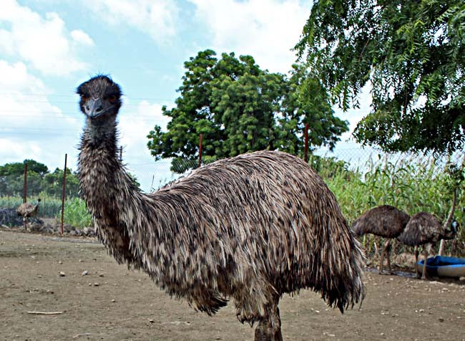
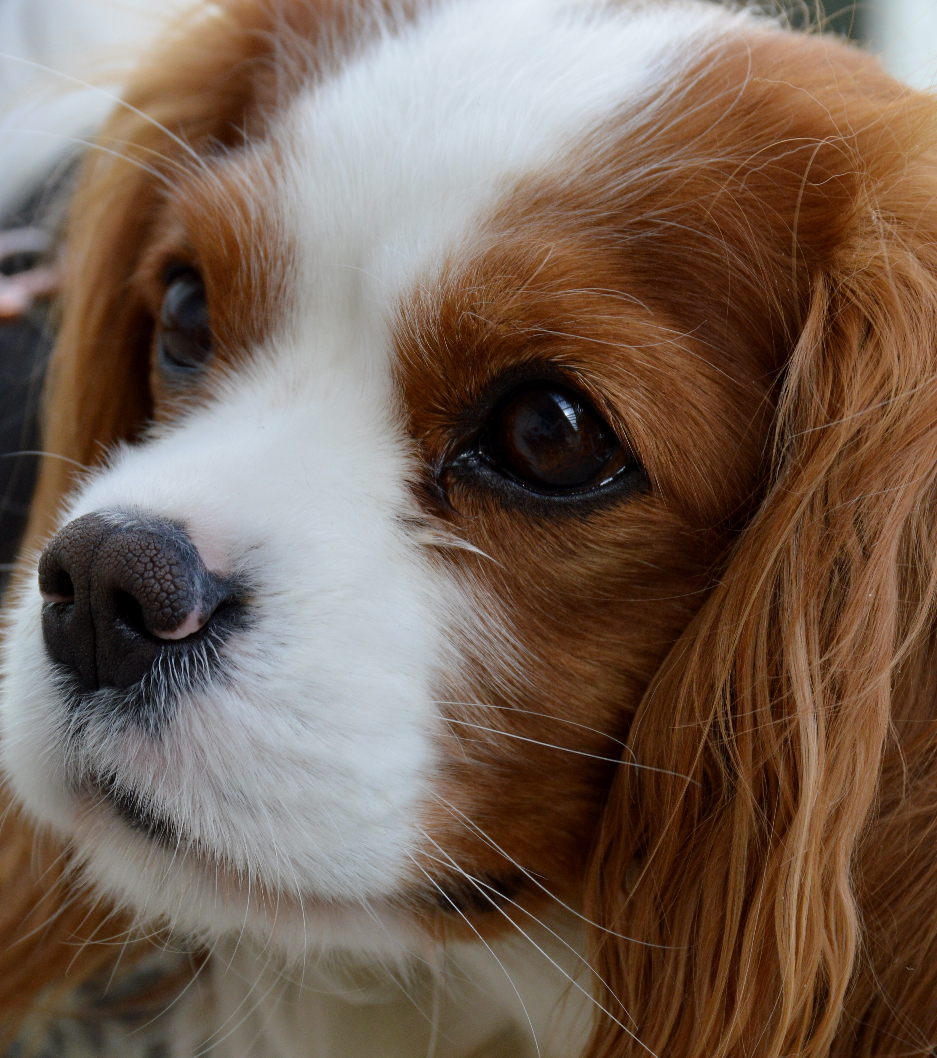
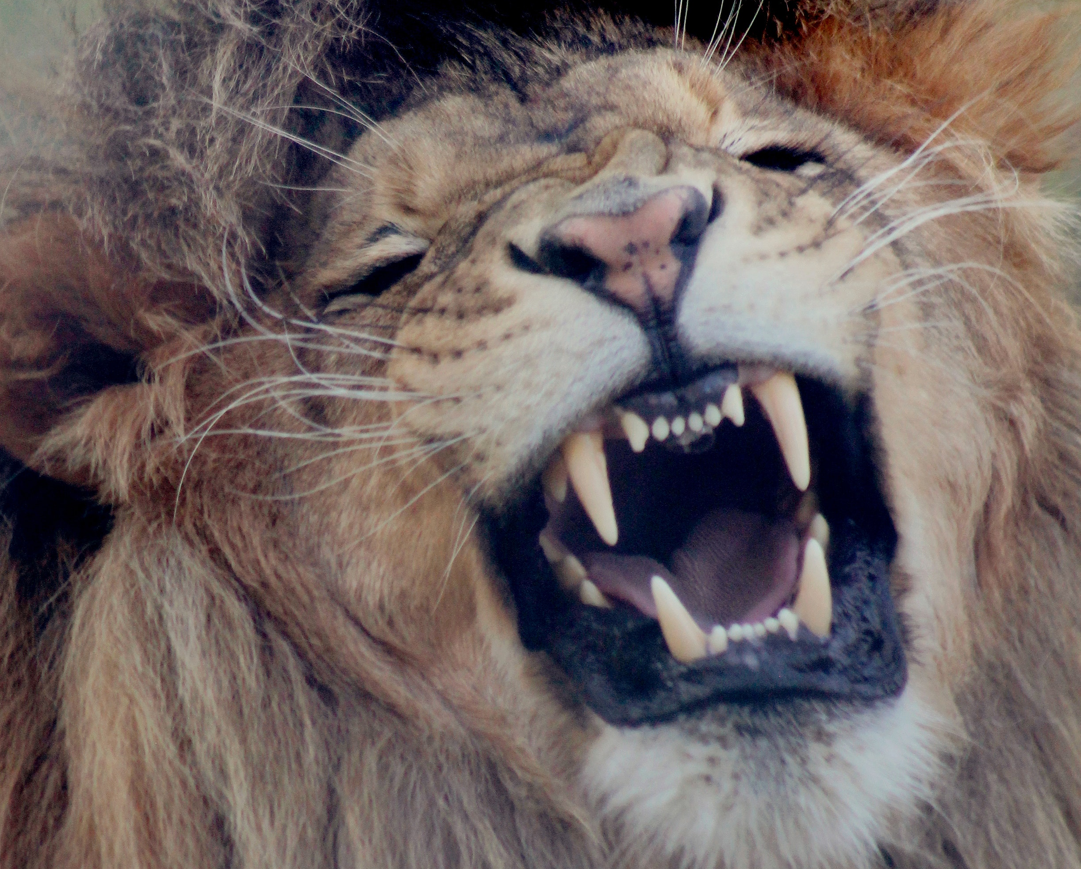
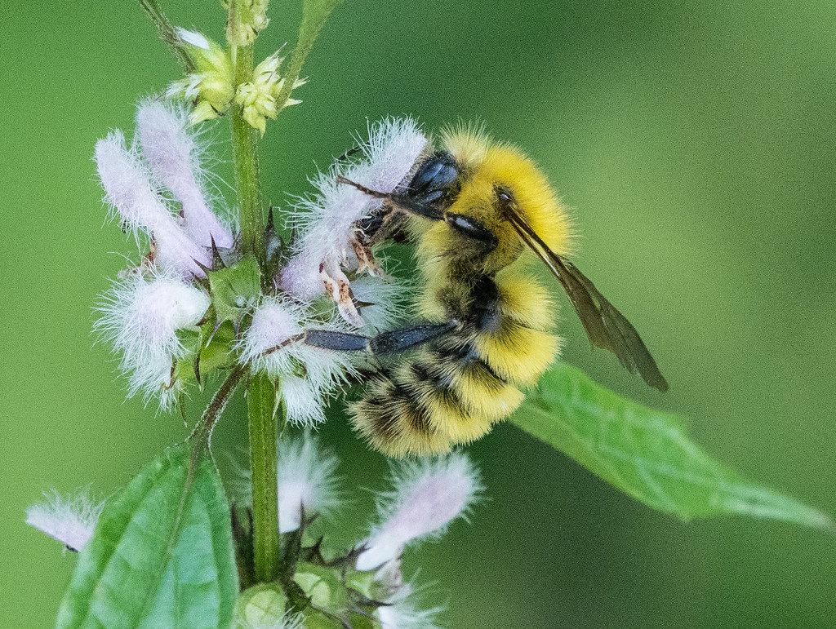

Slide 4
Your turn!
Read each of the sentences written in black.
Decide which sentence fits in which diagram.
Describes the Subject
Renames the Subject
S
LV
PA
S
LV
PN

Slide 5
Emus are tall.
Emus are birds
S
LV
PN
Emus are tall.
Emus are birds.
Renames the Subject
Emus are birds
S
LV
PA
Describes the Subject
Emus are tall

Slide 6
Emus are birds.
Emus are tall.
S
LV
PN
Snakes are reptiles.
Snakes can be long.
Renames the Subject
Snakes are reptiles
Snakes are reptiles.
Snakes can be long.
S
LV
PA
Describes the Subject
Snakes can be long

Slide 7
Emus are birds.
Emus are tall.
.
S
LV
PN
Snakes are reptiles.
Snakes can be long.
Renames the Subject
Dogs are pets
Dogs are pets.
Dogs are cute.
Dogs are pets.
S
LV
PA
Dogs are cute.
Describes the Subject
Dogs are long

Slide 8
Emus are tall.
Emus are birds.
S
LV
PN
Snakes are reptiles.
Snakes can be long.
Renames the Subject
Lions are hunters
Dogs are pets.
Dogs are cute.
Lions are hunters.
Lions are strong.
S
LV
PA
Lions are hunters.
Describes the Subject
Lions are strong.
Lions are strong

Slide 9
Emus are tall.
Emus are birds.
S
LV
PN
Snakes are reptiles.
Snakes can be long.
Renames the Subject
Bees are insects
Dogs are pets.
Dogs are cute.
Lions are hunters.
Lions are strong.
S
LV
PA
Bees are yellow.
Bees are insects.
Describes the Subject
Bees are yellow
Bees are yellow.
Bees are insects.

Slide 10
Renames the Subject
Describes the Subject
S
LV
PN
S
LV
PA
Try your own sentences.
Don't forget periods and capitals!
1.
1.
2.
2.
3.
3.
4.
4.
5.
5.
6.
6.

